Slide 1

Green Pace
Security Policy Presentation
Developer: Michael Duteau

Slide 2

OVERVIEW: DEFENSE IN DEPTH
This policy defines core security principles and a secure coding standard for Green Pace. The goal of this policy is to ensure that security measures are implemented at every stage of development to adhere to Defense-In-Depth principles.

Slide 3
THREATS MATRIX
High priority threats signify a greater need of addressing, as these threats should be tackled from highest to least priority. A threat that is both likely and high priority will likely have the most effect on a product’s cost and time to produce.
Low priority threats should not be ignored but should take less precedence over high priority threats.
Likely STD-002-CPP STD-003-CPP STD-004-CPP STD-005-CPP STD-007-CPP STD-008-CPP STD-010-CPP | Priority STD-003-CPP (18) STD-004-CPP (18) STD-005-CPP (18) STD-002-CPP (12) STD-008-CPP (9) STD-010-CPP (9)
Low priority STD-006-CPP (4) STD-007-CPP (4) STD-009-CPP (4) STD-001-CPP (3) | Unlikely STD-001-CPP STD-006-CPP STD-009-CPP

Slide 4
10 PRINCIPLES
Validate Input Data (STD-003-CPP, STD-004-CPP)
Heed Compiler Warnings (STD-002-CPP, STD-005-CPP, STD-007-CPP)
Architect and Design for Security Policies
Keep It Simple (STD-001-CPP, STD-003-CPP)
Default Deny (STD-004-CPP)
Adhere to the Principle of Least Privilege
Sanitize Data Sent to Other Systems (STD-004-CPP)
Practice Defense in Depth
Use Effective Quality Assurance Techniques (STD-006-CPP)
Adopt a Secure Coding Standard (STD-008-CPP, STD-009-CPP, STD-010-CPP)

Slide 5
CODING STANDARDS
STD-003-CPP: Guarantee that Storage for Strings has Sufficient Space for Character Data
STD-004-CPP: Prevent SQL Injection
STD-005-CPP: Do Not Access Freed Memory
STD-002-CPP: Do Not Read Uninitialized Memory
STD-008-CPP: Do Not Delete a Polymorphic Object Without a Virtual Destructor
STD-010-CPP: Guarantee that Container Indices and Iterators are Within the Valid Range
STD-006-CPP: Understand the Termination Behavior of assert()
STD-007-CPP: Handle All Exceptions
STD-009-CPP: Close Files When They Are No Longer Needed
STD-001-CPP: The One-Definition Rule (ODR)

Slide 6
ENCRYPTION POLICIES
Encryption at rest – Data must be encrypted when it is stored in a solid state such as a HDD, SSD, disk, USB drive, or other storage device.
Encryption in flight – Data must be encrypted when it is being transported from one device to another.
Encryption in use – Data must be encrypted while it is in use to support that sensitive information is encrypted at all stages.

Slide 7
TRIPLE-A POLICIES
Authentication – Verify that the person accessing an account is who they say they are, typically through a username and password pairing.
Authorization – Ensure that the authenticated user has access only to actions that comply with the account’s determined privilege level.
Accounting – Monitor and record user activities, creating and keeping activity logs to always ensure the platform’s security.

Slide 8
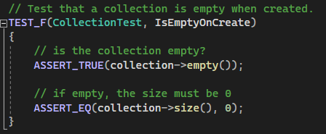
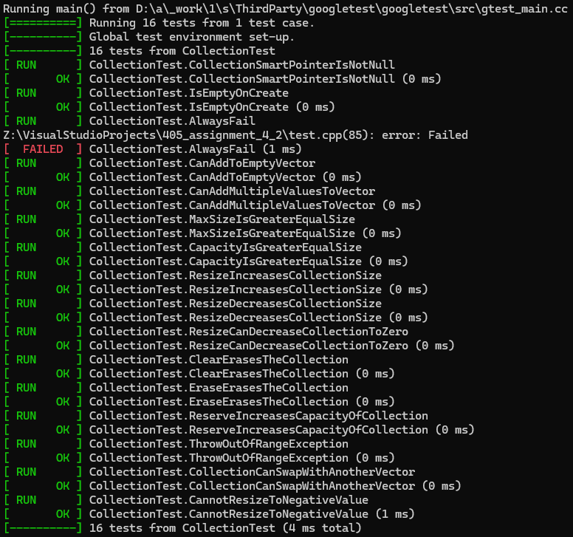
Unit Testing
IsEmptyOnCreate
Test Example
Test Result

Slide 9
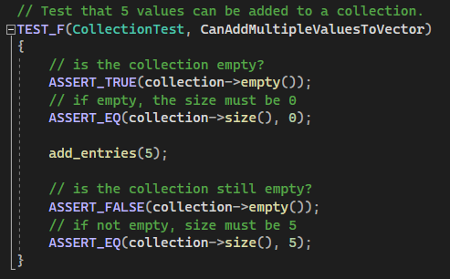
CanAddMultipleValuesToVector
Test Example
Test Result

Slide 10
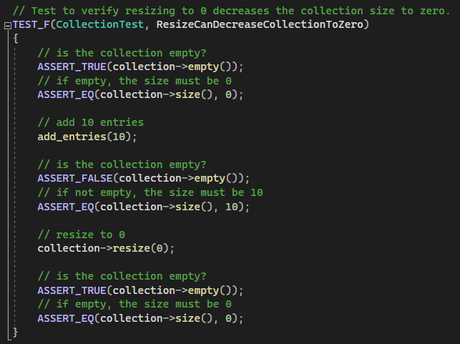
ResizeCanDecreaseCollectionToZero
Test Example
Test Result

Slide 11
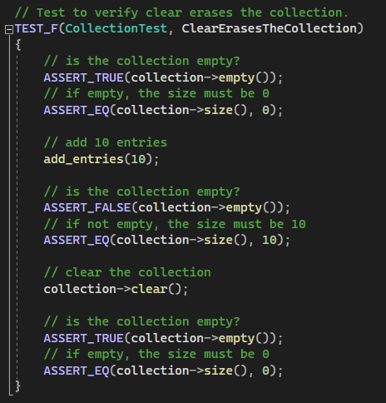
ClearErasesTheCollection
Test Example
Test Result

Slide 12
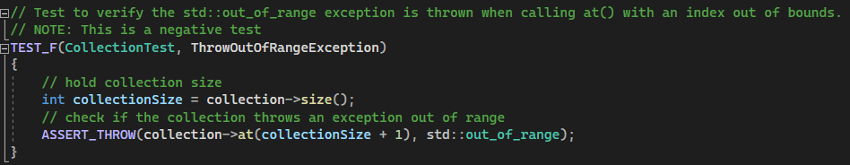
ThrowOutOfRangeException
Test Example
Test Result

Slide 13
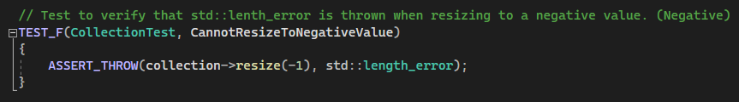
CannotResizeToNegativeValue
Test Example
Test Result

Slide 14

AUTOMATION SUMMARY
Automation will be implemented in numerous areas of development to assist in the reinforcement of the secure coding standards. These methods of automation will enhance existing DevOps procedures to assist in the transition to a more secure standard.
Automation examples include developing countermeasures to predicted attack methods, automated unit and integration testing, as well as penetration testing towards the Production phase.

Slide 15
TOOLS
The DevSecOps Pipelines refers to the addition of security methods to an already existing software development lifecycle (SDLC). Such methods can include “scanning, threat intelligence, policy enforcement, static analysis, and compliance validation” ^{[1]}.
OWASP Threat Dragon ^{[2]} – In the Assess and Plan phase, threat modeling tools such as OWASP Threat Dragon can be used to create threat model diagrams.
GitLab SAST & DAST ^{[3]} – In the Design and Build phases, static application security testing (SAST) and dynamic application security testing (DAST) tools can be utilized to build an application with test-driven design.
Parasoft C/C++test ^{[4]} – In the Verify and Test phase, tools like Parasoft C/C++test can assist in unit and integration testing.
Qualys Continuous Monitoring ^{[5]} – In production and post-production, a continuous security monitoring (CSM) tool such as Qualys can monitor network traffic as well as alert of new vulnerabilities as they arise.

Slide 16
RISKS AND BENEFITS
Benefits
Preventative
Increased security leads to less vulnerabilities and a smoother workflow over time
Security is integrated to all phases of production, making it easier to identify where vulnerabilities occur
Increased defense against attackers and malicious parties
Risks
Upfront costs
Time needed to integrate new standards
Additional training to adhere to new standards
Changes or addition to management may be needed to enforce standards
Addition of new protocols can make workflow more complex to start

Slide 17
RECOMMENDATIONS
The suggested tools in the Tools module are merely examples; time for discussion will be needed to determine which tools will be implemented for their given functions. This may vary based on the cost of the tools and the scope of a given project.
While the proposition of some sort of continuous security monitoring (CSM) can serve as a baseline for the Monitor and Detect phase of production, more consideration will need to be given to what occurs during the Respond phase. While vulnerabilities can be detected and identified, a course of action should be planned for when this occurs.
The adjustment to a new system can be taxing to developers already established within the former DevOps model. Extra time is likely required to help developers become accustomed with new protocols. Temporary weekly workshops or some other educational setting could be implemented to assist developers in getting acquainted with the addition of security and automation within the DevSecOps system.

Slide 18
CONCLUSIONS
Be aware of common threats and their priority levels based on the Coding Standards.
Adhere to the 10 Core Security Principles.
Familiarize yourself with Encryption and Triple-A policies.
Practice Defense In Depth.
Explore different tools to automate different phases of the development lifecycle.

Slide 19
REFERENCES
Seacord, R. C. (2013). Secure Coding in C and C++ (2nd ed.). Pearson Technology Group. https://mbsdirect.vitalsource.com/books/9780132981972
Check Point Software. (2022, September 15). What is a DevSecOps pipeline?. Check Point Software.
https://www.checkpoint.com/cyber-hub/cloud-security/devsecops/what-is-a-devsecops-pipeline/
OWASP Foundaction, Inc. (n.d.). OWASP Threat Dragon. OWASP.
https://owasp.org/www-project-threat-dragon/
Secure your application. GitLab. (n.d.). https://docs.gitlab.com/ee/user/application_security/secure_your_application.html
Comprehensive Test Automation Solutions for C/C++ Software Development. Parasoft. (n.d.). https://www.parasoft.com/products/parasoft-c-ctest/#c-test-capabilities
Qualys, Inc. (n.d.). Qualys Continuous Monitoring. Qualys. https://www.qualys.com/apps/continuous-monitoring/

